Slide 1

Department of CSIT
COURSE NAME
FOUNDATIONS OF CLOUD-NATIVE COMPUTING & DEVOPS
COURSE CODE –24CS2260F
Topic:
Image Scanning & SBOM awareness
Session -

Slide 2
Docker image Scanning
While more and more companies are adapting containerization in their infrastructure and application deployment, scanning the images for any vulnerabilities and resolving it becomes a norm practice for a DevOps Engineer
Dealing with docker image scanning and cleanup and the tool that we will be utilising for it will be Trivy.
Docker image scanning checks for security vulnerabilities and software issues in a container.
Ensures safe deployment by identifying bugs or flaws before they affect the system.
Helps find outdated libraries, missing patches, or known security risks.
Example: Scanning a Docker image for a web app ensures it doesn't contain vulnerabilities that hackers could exploit.

Slide 3
Procedure to scan the docker prebuilt image and custom docker image
Install Trivy
Verify Installation
trivy –version
3. Scan a Docker Image eg:nginx prebuilt image
Command:
trivy image nginx:latest
4. Understand the Output
Trivy will return a list of vulnerabilities found in the image, including:
Vulnerability ID
Package Name
Severity Level (e.g., High, Medium, Low)
Description of the issue
Fix Information (if available)

Slide 4
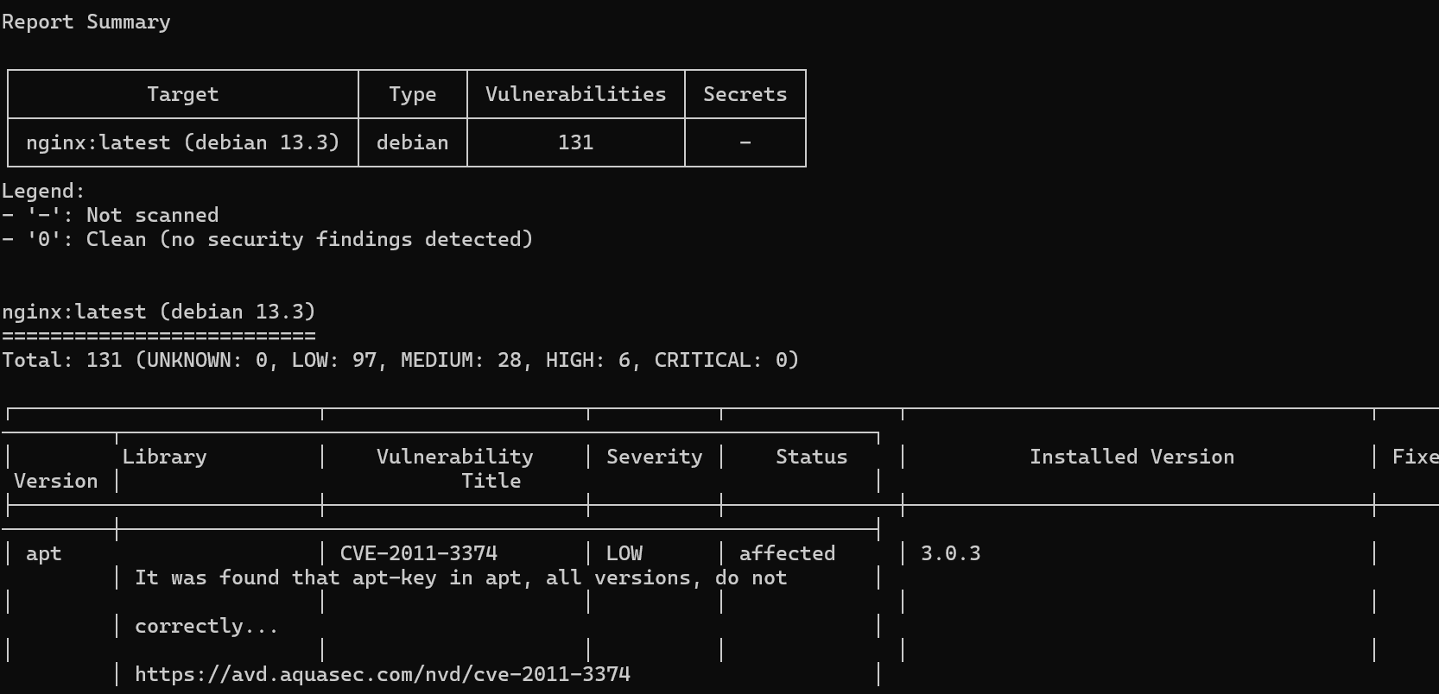
Output

Slide 5
SBOM (Software Bill of Materials)is a rich, multi-dimensional document that captures not just what components are present, but their relationships, origins, security status, and legal implications
Why Container SBOMs Matter
Container images contain multiple layers of dependencies:
Base operating system packages
Runtime dependencies
Application libraries and frameworks
Development and build tools (in multi-stage builds)
Configuration files and certificates

Slide 6
Container SBOMs help organizations:
Track vulnerabilities across the entire container stack
Meet compliance requirements for containerized applications
Implement security policies based on component inventory
Respond quickly to supply chain security incidents
Optimize image size by identifying unnecessary components
SBOM formats:
JSON,XML,CSV,YAML,RDF etc..

Slide 7
Why SBOM is Important for Containers in CI/CD
Tracking Components: Containers often rely on multiple open-source libraries, services, or packages. An SBOM allows developers to see all these dependencies in one place.
Security and Vulnerability Management: Vulnerabilities in the libraries or tools used inside a container can be a security risk. An SBOM allows teams to quickly track which versions of components are inside the container and alert them if any of those components have known vulnerabilities.
Audit and Compliance: SBOMs provide a traceable record of the components used in a containerized application. This is especially important for industries with strict regulatory or compliance requirements, like finance or healthcare.

Slide 8
Incorporating SBOM into CI/CD Pipelines
In a CI/CD pipeline for containers, you can automatically generate and manage SBOMs in several stages:
Build Stage: When you build a container image (using a tool like Docker), generate an SBOM that lists the components included in that image. This can be done by using tools like Syft or CycloneDX to analyze the image and produce an SBOM.
Test Stage: Ensure that your container image doesn’t include vulnerable components by integrating SBOM scanning tools. Tools like Grype (by Anchore) or Trivy can scan your container images against known vulnerabilities and reference them in the SBOM.

Slide 9
Release/Deploy Stage: Once the container is ready for deployment, the SBOM can be bundled along with the container image. This ensures that anyone using the image (like in production) has visibility into the components and dependencies it contains.
Security Alerts: Once an SBOM is created, tools can track vulnerabilities and alert you whenever one of the libraries used in the container has a new security issue. This ensures fast action to mitigate risks.

Slide 10
Tools for SBOM in CI/CD for Containers
Several tools and standards have emerged to help generate and manage SBOMs in containerized environments:
Syft: A tool to generate an SBOM for container images, file systems, or directories.
CycloneDX: A lightweight SBOM standard for application security, often used in container environments.
Trivy: A vulnerability scanner for containers, which also generates an SBOM to track dependencies and potential security issues.
Grype: A vulnerability scanner that can integrate with CI/CD pipelines to scan container images based on their SBOM.

Slide 11
Steps, you ensure that your Docker images are secure and vulnerabilities are addressed before deployment.
Procedure:
Install Syft on Windows (download the .zip release from GitHub, extract, and add it to your PATH).
Build the Docker Image using the docker build command in your CI pipeline.
Generate SBOM using Syft:
command-
syft my-node-app -o json > sbom.json
4. Install Grype on Windows and use it to scan the generated SBOM for vulnerabilities:
command-
grype sbom:sbom.json

Slide 12

THANK YOU
Team –Foundations Of Cloud-native Computing & Devops

